Slide 1
Accelerometer
Which way is up?

Slide 2
Origins
Electromechanical device that will measure acceleration forces
These forces may be static
like the constant force of gravity pulling at your feet
Or dynamic
caused by moving or vibrating the accelerometer.

Slide 3
Use
By measuring the amount of static acceleration due to gravity, you can find out the angle the device is tilted at with respect to the earth
By sensing the amount of dynamic acceleration, you can analyse the way the device is moving
Measuring tilt and acceleration – excitement can’t be contained…
There are a lot of uses

Slide 4
Uses
To understand its surroundings better
Is it driving uphill?
Is it going to fall over when it takes another step?
Is it flying horizontally?
Can write code to answer all of these questions using the data provided by an accelerometer
An accelerometer can help analyze problems in a car engine using vibration testing, or you could even use one to make a musical instrument

Slide 5
Uses
In the computing world
using accelerometers in their laptops to protect hard drives from damage. If you accidentally drop the laptop, the accelerometer detects the sudden freefall, and switches the hard drive off so the heads don't crash on the platters
High g accelerometers are the industry standard way of detecting car crashes and deploying airbags at just the right time
(watch out for the acceptable time delay – sense the crash to fully deploy the airbag must be less than 500milliseconds)

Slide 6
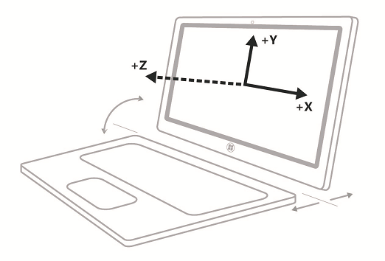
3 axes

Slide 7
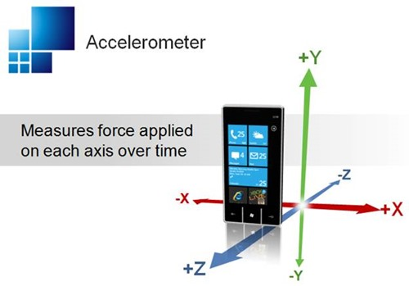

Slide 8
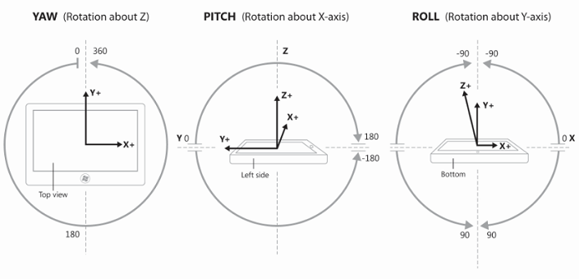
Roll, Pitch, Yaw

Slide 9
Detailed information
Available from Texas Instruments
http://www2.usfirst.org/2005comp/Manuals/Acceler1.pdf
Explains the basics and the different concepts very well
Most electronic devices use the three axes, cars only use two (for obvious reasons)

Slide 10
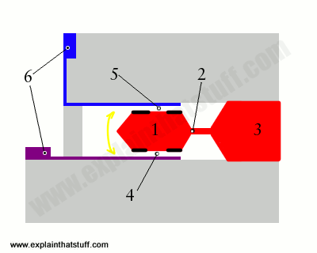
explainthatstuff
Red electrode (1) (electrical terminal) has enough mass to move up and down very slightly when you move or tilt the accelerometer
Electrode supported by a tiny beam (cantilever) that's rigid enough to hold it but flexible enough to allow it to move (2)
Electrical connection (3) from the cantilever and electrode to the outside of the chip so it can be wired into a circuit
Below and separated from it by an air gap, there's a second electrode (4) (purple)
Air gap between the two electrodes means the red and purple electrodes work together as a capacitor
As accelerometer moves, red electrode moves up and down. The distance between the red and purple electrodes changes, and so does the capacitance between them. Small bits of insulation (shown as black lines) prevent the red electrode from making direct electrical contact with the purple one if the accelerometer experiences a really big force (a sudden jolt)

Slide 11
explainthatstuff
blue electrode above the red electrode and another air gap making a second capacitor (5)
electrodes are connected to more electrical terminals at the edges of the chip, again, so it can be wired to a bigger circuit
Capacitors used in accelerometers to measure force
if a moving mass alters the distance between two metal plates, measuring the change in their capacitance gives a measurement of the force that's acting

Slide 12
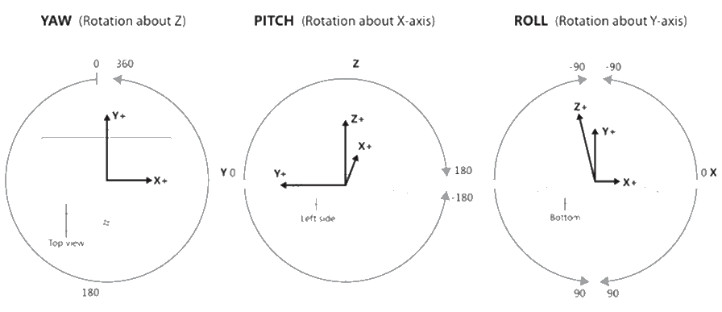
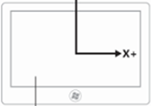


Pitch, yaw, roll
Pitch – X, Roll – Y, Yaw – Z

Slide 13
Windows 10 UWP
Accelerometer is a class provided
Used to access the sensor and get information about the device location and movement
Events:
ReadingChanged – occurs when the accelerometer reports a new reading
Shaken – detects that the device has been shaken
Methods:
GetCurrentReading
GetDefault – returns a handle to the current accelerometer

Slide 14
Windows 10 UWP
Applications use the methods to determine whether the readings have changed or the device has been shaken
Use the properties to retrieve and adjust the sensor report interval
Sensor data provided relative to the devices fixed sensor coordinate system (independent of display orientation)
If the application relies on sensor data for input control or to manipulate elements on the screen, then take current display orientation into account and compensate appropriately
Compass application and flipped views for example

Slide 15
Windows 10 UWP
Get a handle to the accelerometer
If none exists, then null will be returned
Need to set up the necessary event handlers after the accelerometer is returned
Found in Windows.Devices.Sensors
_accelerometer = Accelerometer.GetDefault();

Slide 16
if (_accelerometer != null)
{ // Establish the report interval
_accelerometer.ReadingChanged +=
new TypedEventHandler<Accelerometer,
AccelerometerReadingChangedEventArgs>(ReadingChanged);
}
else
{
rootPage.NotifyUser("No accelerometer found",
NotifyType.StatusMessage);
}

Slide 17
async private void ReadingChanged(object sender,
AccelerometerReadingChangedEventArgs e)
{
await Dispatcher.RunAsync(CoreDispatcherPriority.Normal, () =>
{
AccelerometerReading reading = e.Reading;
ScenarioOutput_X.Text =
String.Format("{0,5:0.00}", reading.AccelerationX);
ScenarioOutput_Y.Text =
String.Format("{0,5:0.00}", reading.AccelerationY);
ScenarioOutput_Z.Text =
String.Format("{0,5:0.00}", reading.AccelerationZ);
});
}

